Slide 1
Component based software development & software middleware
Lorenzo Natale
iCub Facility
Istituto Italiano di Tecnologia, Genova, Italy
Winter School on Humanoid Robot Programming
Santa Margherita Ligure, 30 Jan- 8 feb 2017

Slide 2
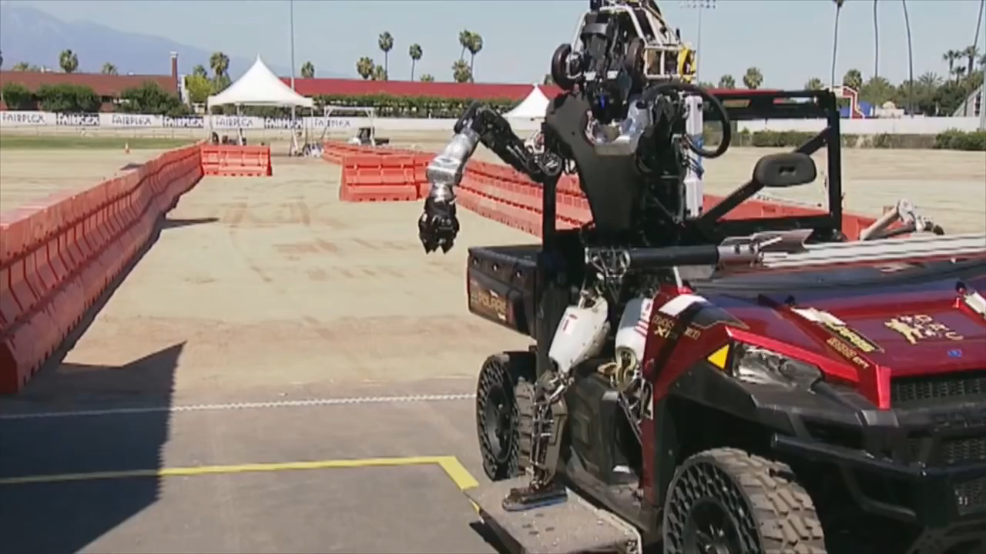

Slide 3
Due to a human programming error, the robot fell when transitioning from the driving task to the egress task (the foot throttle controller wasn’t turned off). This caused the robot to the fall and faceplant out of the car onto the asphalt (source: http://drc.mit.edu/)

Slide 4
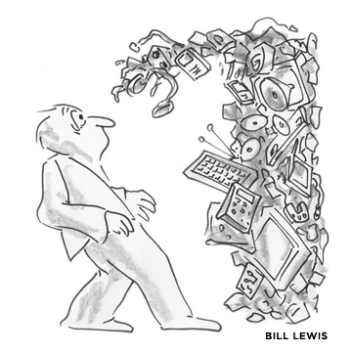
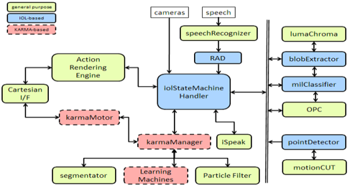
System Integration

Slide 5
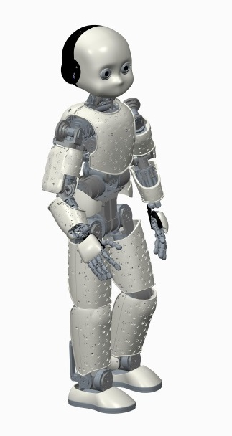
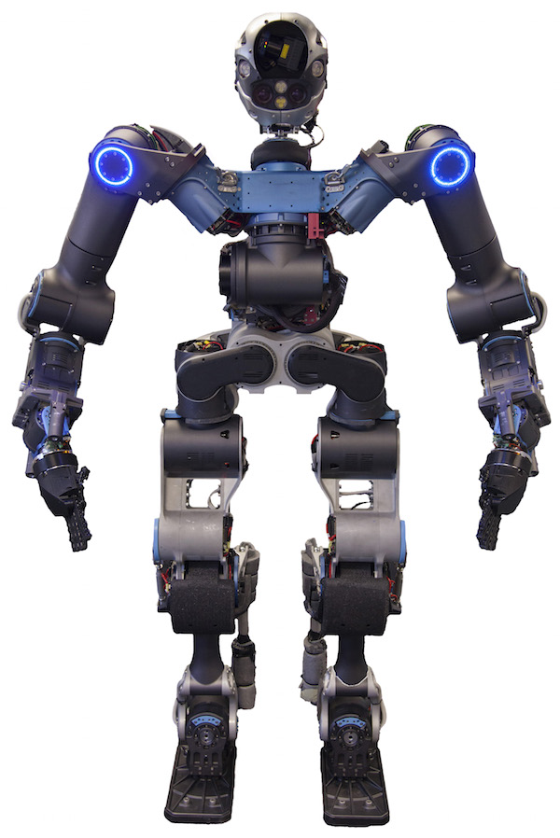
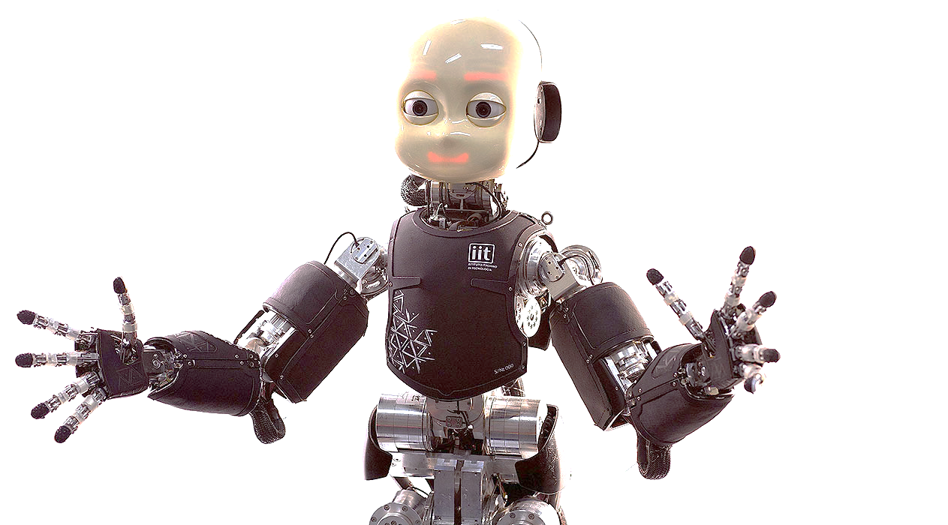
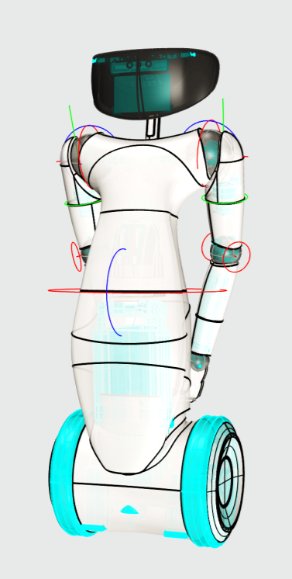
Key issues
Complexity: distributed processing, heterogeneous systems, noise, real-time
Asynchronous development
Variability: various scenarios and platforms
Fast prototyping
Lack of standards
Fluctuation in hardware and algorithms, lots of open questions

Slide 6
Approach
Major cost in software development is debugging, recycling code is key
Component driven software development
Middleware: factor out platform specificities
Hardware (robot abstraction layer)
Communication
Operating system
Parameters
Computing infrastructure
Recently: test driven development

Slide 7
Component driven software development
Computation
Communication
Configuration
Coordination
Composition
What we are interested in
Dependent on the hardware, network topology
Application dependent
BRICS Component Model, 2013

Slide 8
output myAlgorithm(input)
{
...
data=readSensor() //call device driver
out = call alg1(data)
…
out = call alg2(data)
controlMotors(out) //call device driver
…
}
output alg1(input)
{code}
output alg2(input)
{code}

Slide 9
output myAlgorithm(input)
{
data=readSensor() //call device driver
out = query(alg1, data)
…
out = query(alg2, data)
controlMotors(out) //call device driver
…
}
output alg1(input)
{code}
output alg2(input)
{code}
Program1
Robot
myAlgorithm()
drivers
middleware
middleware
hardware
Operating System facilities: Network or shared memory
Program2
Program2
alg1()
alg2()
middleware
middleware

Slide 10
Component driven development
Modular software: simple structure, data encapsulation, interface
Reconfigurable components
Reduced coupling: interaction between components happens through pre-defined standards (no direct inclusion of header files)
Language independent

Slide 11
Middleware: general concepts
Information sharing model
Serialization, Interface Definition Language
Communication model, timing
Data persistency
Hardware abstraction layer

Slide 12
Information sharing model
Data ports
Services
Data centric (blackboard)
Component
Component
Client
Server
Client
Component
Blackboard
Component
Component

Slide 13
Serialization
Class Point3D
{
int x;
int y;
int z;
}
Point3D::serialize()
Point3D::deserialize()
0x100
X:100
300
…
…
…
0x204
Point3D
0x104
Y:200
100
200
300
X:???
0x208
Z:300
Y:???
0x20C
Point3D
0x108
Z:???
0x210
0x10C
…
…
100
200
…
…
…
…
Network
4 bytes
4 bytes
Computer 1
Computer 2

Slide 14
Serialization
Class Point3D
{
int x;
int y;
int z;
char *more;
}
Point3D::serialize()
Point3D::deserialize()
0x100
X:100
300
…
…
…
0x204
Point3D
0x104
Y:200
999
100
200
300
X:???
0x208
Z:300
Y:???
0x20C
Point3D
0x108
Z:???
0x210
0x10C
More: 0x200
…
100
200
…
…
…
More:0x300
999
Network
???
4 bytes
4 bytes
Computer 1
Computer 2

Slide 15
Interface Definition Language
Allows describing types
A compiler generate required code to define the type, including serialization functions
Language independent, if the middleware is cross-language
Point3D.h/Point3D.cpp
class Point3D
{
int x;
int y;
int z;
serialize();
deserialize();
}
IDL compile
point3d.thirft
struct Point3D {
1: i32 x;
2: i32 y;
3: i32 z;
}

Slide 16
Communication model
Remote Procedure Calls (RPC)
Remote invocation of an object
Synchronous nature (although variant exists)
Publish/Subscribe
Space, time, synchronization decoupling

Slide 17
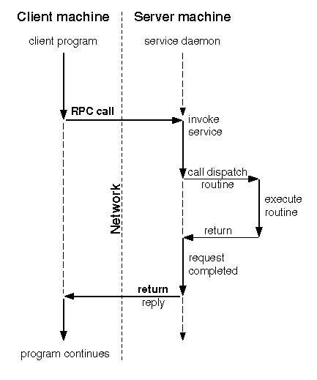
Timing in RPC

Slide 18
Decoupling in publish-subscribe
Space decoupling: the interaction parties do not need to know each other; publisher publish events through an event service and the subscribers get these events indirectly through the event service
Time decoupling: interaction parties do not need to be actively participating in the interaction at the same time, publisher might publish events while subscribers is disconnected and subscribers might get notified of an event while the original publisher is disconnected
Synchronization decoupling: publishers are not blocked while producing events and subscribers can get asynchronously notified (through callback) of the occurrence of the event while performing concurrent activity
Eugster, et al., The Many Faces of Publish/Subscribe, 2003.

Slide 19
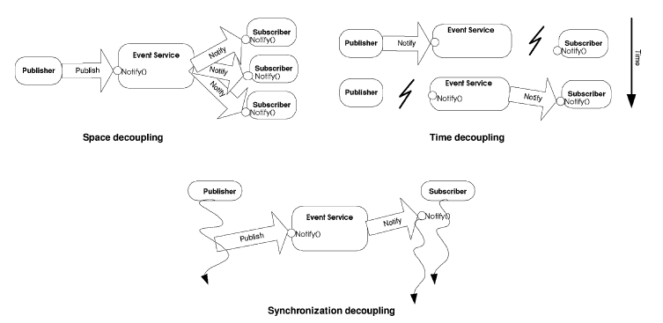
Eugster, et al., The Many Faces of Publish/Subscribe, 2003.

Slide 20
Data storage (persistency)
What happens when the sender is faster than the receiver?
Buffering:
First In First Out (messages are queued, at the cost of latency)
Oldest Packet Drop: minimize latency, drop messages if required

Slide 21
Reducing latency/memory copies
Point3D::serialize()
Point3D::deserialize()
0x100
X:100
300
…
…
…
0x204
Point3D
0x104
Y:200
100
200
300
X:???
0x208
0x108
Z:300
Y:???
0x20C
0x10C
…
Z:???
0x210
…
100
200
…
…
…
…
Component1
Network
4 bytes
Computer 1
Computer 2

Slide 22
Reducing latency/memory copies
Point3D::serialize()
Point3D::deserialize()
0x100
X:100
300
…
…
…
0x204
Point3D
0x104
Y:200
100
200
300
X:???
0x208
0x108
Z:300
Y:???
0x20C
0x10C
…
Z:???
0x210
…
100
200
…
…
…
…
Component1
Network
4 bytes
Computer 1
…
0x204
X:???
0x208
Y:???
0x20C
Z:???
0x210
…
Component2
4 bytes
Computer 2

Slide 23
Reducing latency/memory copies
Point3D::serialize()
Point3D::deserialize()
0x100
X:100
300
…
…
…
0x204
Point3D
0x104
Y:200
100
200
300
X:???
0x208
0x108
Z:300
Y:???
0x20C
0x10C
…
Z:???
0x210
…
100
200
…
…
…
…
Component1
Network
4 bytes
Point3D::deserialize()
Computer 1
…
0x204
X:???
0x208
Y:???
0x20C
Z:???
0x210
…
Component2
4 bytes
Computer 2

Slide 24
Reducing latency/memory copies
Point3D::serialize()
Point3D::deserialize()
0x100
X:100
300
…
…
…
0x204
Point3D
0x104
Y:200
100
200
300
X:???
0x208
0x108
Z:300
Y:???
0x20C
0x10C
…
Z:???
0x210
…
100
200
…
…
…
…
Component1
Network
4 bytes
Point3D::deserialize()
Computer 1
…
0x204
X:???
0x208
Y:???
0x20C
Z:???
0x210
…
Component2
Not necessary copies! (overhead, especially for large data like images)
4 bytes
Computer 2

Slide 25
Reducing latency/memory copies
Zero-copy
Point3D::deserialize()
0x100
X:100
300
…
…
…
0x204
Point3D
0x104
Y:200
X:???
0x208
0x108
Z:300
Y:???
0x20C
0x10C
…
Z:???
0x210
…
100
200
…
…
…
…
Component1
Network
4 bytes
Point3D::deserialize()
…
0x204
Computer 1
X:???
0x208
Y:???
0x20C
Z:???
0x210
…
Component2
Not necessary copies! (overhead, especially for large data like images)
4 bytes
Computer 2

Slide 26
Reducing latency/memory copies
Zero-copy
Component1 private memory
Copy-once
Point3D
0x100
X:100
0x104
Y:200
0x108
Z:300
0x10C
…
…
…
100
200
…
…
X:???
Component1
…
Y:???
Z:???
Network
…
4 bytes
Shared memory
Component2
Computer 1
Component2 private memory
Not necessary copies! (overhead, especially for large data like images)
Computer 2

Slide 27
Which Middleware
Robot Operating System (ROS)
YARP
OROCOS
SmartSoft
CORBA
ICE
OMG DDS
Many others: OpenRDK, Mira…

Slide 28
ICE/CORBA/COM-DCOM
Remote object invocation
An object-oriented specification language
Synchronous/asynchronous
May have deployment tool, versioning etc..

Slide 29
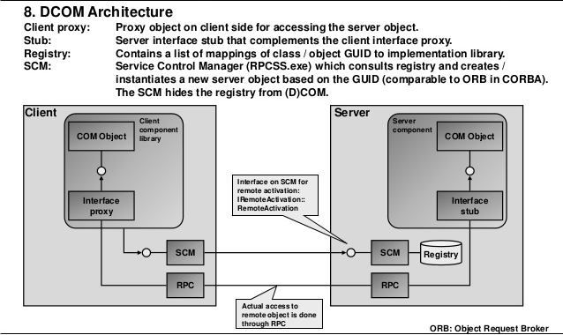

Slide 30
OROCOS: Open Robot Control Software
Kinematics and Dynamics Library and Bayesian Filtering Library
Real-Time Toolkit: it provides the infrastructure and the functionalities to build real-time robotics applications in C++
OROCOS Component Library: ready to use components
Coordination
Communication
Configuration

Slide 32
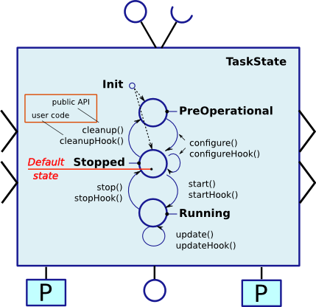
Component lifecycle

Slide 33
Model Driven Software Engineering
Models can make a particular system or phenomenon easier to understand, quantify, visualize simulate, or predict
Models are used in many fields of engineering, either graphical (architecture) or textual (equations of physics)
They are created using modeling languages (Domain specific languages, or DSLs)
Software engineering can greatly benefit from the use of models because software and models have the same nature, and it is easy to automate the process of software generation and analysis
Example: SmartSoft MDE toolchain
From: D. Brugali, Model-Driven Software Engineering in Robotics, IEEE Robotics and automation magazine, Sept. 2015

Slide 34
<<component>>: elemental components
<<subsystem>>: composite components
Each component is characterized by a set of ports, interaction point with other components
Provide and requested interfaces
Connectors: Caller/Provider, Publisher/Subscriber

Slide 35
From an architectural model it is possible to generate platform specific code templates (that implement the specified architecture and include calls to the target framework, i.e. the middleware)
Code templates is complemented with code provided by the developer (specific robot functionalities) to produce executable code
Challenges: hardware requirements, real-time constraints, embedded and distributed systems, many application scenarios, dynamic interaction with the environment
DSL for robotics should include: timing constraints, communication infrastructure, allocation of threads and processes to difference processors

Slide 36
YARP/ROS
Components are executables which communicate through well-defined named objects called Ports (YARP), Topics (ROS)
A central server (yarpserver/roscore) keeps tracks of names and allows Ports/Topics to be reachable
Communication is peer-to-peer between Ports/Topics

Slide 37
YARP approach
Simplified form of publish-subscribe
Observer patter: subscribers register their interest directly with publishers, which mange subscriptions and sends events
Communication is asynchronous or synchronous
Space decoupling
Connections are dynamic
Remote procedure calls for server-client type of communication
See also:
YARP: Yet Another Robot Platform, G. Metta, P. Fitzpatrick, L. Natale, 2006
Design of Dynamically Reconfigurable Real-time Software Using Port-Based Objects, Stewart et al., 1997

Slide 38
yarpserver
Register /source, 192.168.1.3:10001
Register /pos, 192.168.1.3:10002
Query /camera …
Query /cmd …
Register /camera, 192.168.1.4:10001
Register /cmd, 192.168.1.4:10002
Query /camera …
Query /cmd …
mcast
udp
/source
/camera
udp/tcp
/cmd
/pos
Process 1
Process 2
/source2
connect /camera /source
connect /pos /cmd
Process 3
connect /camera /source2 mcast

Slide 39
YARP/ROS comparison
YARP
ROS
Run-time reconfiguration of connections
Pluggable protocols and devices
Multicast for efficient one-to-many communication
Multi-platform
QoS, channel prioritization
LGPL/GPL
Smaller community
No packet management
ROS compatible protocol
Strongly typed
Rich set of libraries and tools
Eco-system, very active community
Packet management
BSD license
Ubuntu based
Restricted set of protocols
All connections from a topic use the same protocol

Slide 40
Data Distribution Service
Omg standard (int. consortium of many companies, proposers of various standards, e.g. UML, CORBA,
Data (as opposed to message) centric
Share data even between time-decoupled publishers and consumers
Interest-based filter on content, age and/or lifecycle
DDS dynamically discovers publishers and subscribers (no central server naming server), determines data they share and Quality of Service (QoS)
For example, if a subscriber requires an update every 10ms and its matched publisher does not deliver, the system declares an error, enabling remedial action
QoS: urgency, importance, reliability, persistence, and liveliness
It is built on two standards: real-time wire protocol (RTPS) and C++ API
Several implementations exists: proprietary as well as open source (opensplice, opendds, RTI connext)
ROS 2.0 is going to be based on DDS

Slide 41
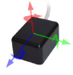
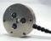
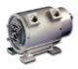
Robot Abstraction Layer
Robot Interface
Loops on board
…
…
read encoders
read IMU
read FT
…
get image
...
set position
Robot

Slide 42
Robot Abstraction Layer
External loops
Network Stub
Robot Interface
Network
…
…
read encoders
read IMU
read FT
…
get image
...
set position
.
Network Stub
Robot Interface
Loops on board
…
…
read encoders
read IMU
read FT
…
get image
...
set position
Robot

Slide 43
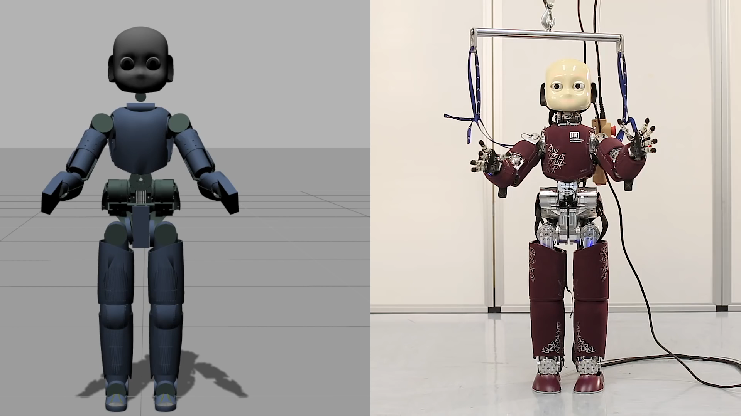

Slide 44
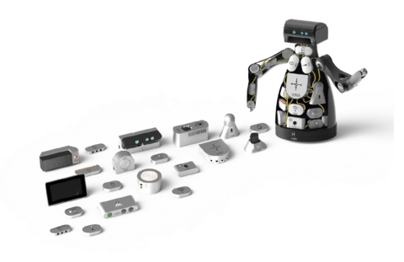
Similar approachers
ROS Control
H-ROS

Slide 45
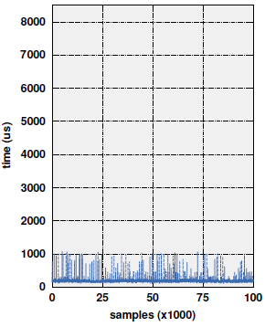
Why Channel Prioritization (QoS)
HOST1
Robot

Slide 46
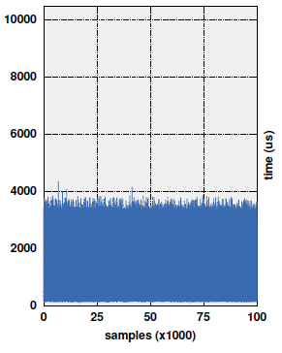
HOST1
20% load
Robot
switch

Slide 47
Channel prioritization
Bottlenecks
Robot
HOST1
HOST2
switch
Determinism is affected by:
Thead scheduling (CPU usage)
Packet conflicts (network usage)

Slide 48
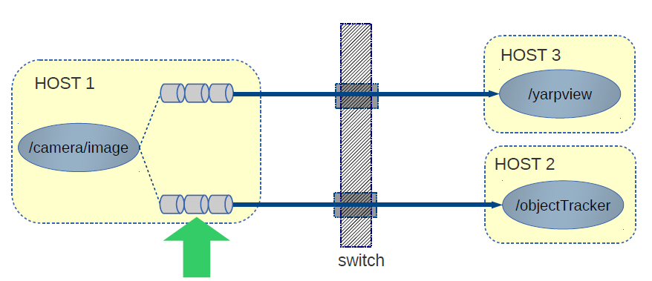
Approach: improve determinism by increasing thread priorities and reducing network bottlenecks using QoS
> prop sched policy 1 priority 30
> prop set qos priority HIGH
Paikan et al., A Best-Effort Approach for Run-Time Channel Prioritization in Real-Time Robotic Application IROS 2015

Slide 49
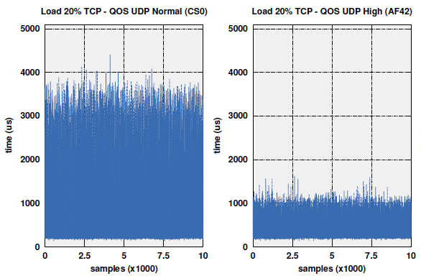
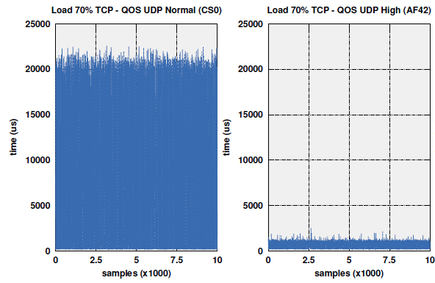
20%/70% load
HOST1
Robot
switch
Standard YARP (20%)
With priority (20%)
Standard YARP (70%)
With priority (70%)

Slide 50
An application

Slide 51
References
Ali Paikan, Silvio Traversaro, Francesco Nori and Lorenzo Natale, "A Generic Testing Framework for Test Driven Development of Robotic Systems", In Lecture Notes in Computer Science (MESAS15), Springer, pp. , 2015
Paikan, A., Domenichelli, D., and Natale, L., Communication channel prioritization in a publish-subscribe architecture, in Proc. Software Engineering and Architectures for Realtime Interactive Systems Workshop, Arles, France, 2015.
Paikan, A., Tikhanoff, V., Metta, G., and Natale, L., Enhancing software module reusability using port plug-ins: an experiment with the iCub robot, in Proc. IEEE/RSJ International Conference on Intelligent Robots and Systems, Chicago, Illinois, 2014.
Fitzpatrick, P., Ceseracciu, E., Domenichelli, D., Paikan, A., Metta, G., and Natale, L., A middle way for robotics middleware, Journal of Software Engineering for Robotics, vol. 5, no. 2, pp. 42-49, 2014.
Paikan, A., Fitzpatrick, P., Metta, G., and Natale, L., Data Flow Port's Monitoring and Arbitration, Journal of Software Engineering for Robotics, vol. 5, no. 1, pp. 80-88, 2014
Metta, G., Fitzpatrick, P., Natale, L., YARP: Yet Another Robot Platform, International Journal of Advanced Robotics Systems, special issue on Software Development and Integration in Robotics, Volume 3, Issue 1, pp. 43-48, March 2006
Patrick Th. Eugster, Pascal A. Felber, Rachid Guerraoui, and Anne-Marie Kermarrec. 2003. The many faces of publish/subscribe. ACM Comput. Surv. 35, 2 (June 2003), 114-131.
David, B. Stewart, Richard, A. Volpe, Pradeep, K. Khosla, Design of Dynamically Reconfigurable Real-Time Software Using Port-Based Objects, IEEE Trans. On Software Engineering, 23(12), 1997
Dušan Bálek, František Plášil, Software Connectors and Their Role in Component Deployment, New Developments in Distributed Applications and Interoperable Systems, 70, 2002, pp. 69-84.
Farhad Arbab: Reo: a channel-based coordination model for component composition. Mathematical Structures in Computer Science 14(3):329--366, 2004.
D. Brugali, Model-Driven Software Engineering in Robotics, IEEE Robotics and automation magazine, Sept. 2015

Slide 52
Questions?

Slide 53
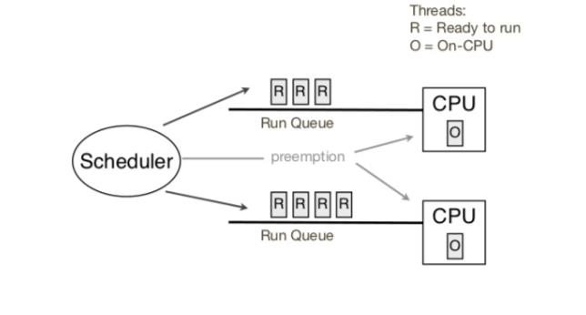
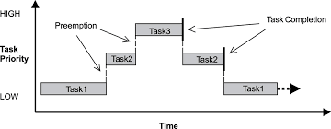
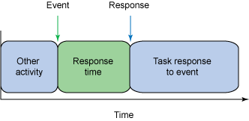
Threads and scheduling, quick overview
Issues:
Scheduling and interrupt latency
Certain operations may be blocking i.e. not preemptable (usually system calls)
System calls: file management, process management, I/O, memory requests, communication (shared memory), error handling

Slide 54
Interfaces
Robot abstraction layer: interfaces to motors and sensors minimize the impact of changes in the hardware
Custom interfaces and data types (Thrift IDL)
point3d.thirft
struct Point3D {
1: i32 x;
2: i32 y;
3: i32 z;
}
adder.thirft
service Adder {
/** … */
i32 get_answer();
/** … */
bool set_answer(1:i32 val)
/** … */
i32 add (1:i32 x);
}

Slide 55
Carrier plugins
YARP Camera /camera
YARP
receiver
yarp connect /camera /receiver
MJPG camera
YARP
receiver
http://65.52.88.202:5159
yarp connect /65.52.88.202:5159 /receiver mjpeg
ROS Camera
Node: /camera
Topic: /image
YARP
receiver
yarp connect /image@/camera /receiver
Camera.msg

Slide 56
More on YARP-ROS (1)
YARP protocols for rostcp and xmlrpc
Compatibility with roscore
YARP can interpret ROS messages, statically or dynamically
Extended YARP’s API (nodes, publishers, subscribers)
#include "Pose.h"
#include "Twist.h"
/* create ROS Node /controller */
yarp::os::Node node("/controller");
/* create a subsriber for Pose.msg */
yarp::os::Subscriber<Pose> pose;
/* subscribe to /turtle1/pose */
pose.topic("/turtle1/pose");
/* create a publisher for Twist.msg */
yarp::os::Publisher<Twist> cmd;
/* publish to /turtle1/cmd_vel */
cmd.topic("/turtle1/cmd_vel");
/* read a new value from the topic */
pose.read(p);
/* publish the command */
cmd.write(t);
Pose.msg
Pose.h
Twist.msg
yarpidl_rosmsg
Twist.h

Slide 57
ROS+YARP machine
[type] BEGIN turtlesim/Pose
[type] float32 x
[type] float32 y
[type] float32 theta
[type] float32 linear_velocity
[type] float32 angular_velocity
[type] END turtlesim/Pose
yarpidl_rosmsg –name /typ@yarpidl
ROS types
turtlesim/Pose?
YARP machine
ROS machine
C:\yarp read /turtle1/pose@/reader
yarp: Receiving input from /turtlesim to
/turtle1/pose-@/reader
5.544445 5.544445 0.0 0.0 0.0
5.544445 5.544445 0.0 0.0 0.0
...
$ rosrun turtlesim turtlesim_node
[ INFO] [1444722896.501281004]: Starting turtlesim with node name /turtlesim
turtlesim/Pose
[Data]

Slide 58

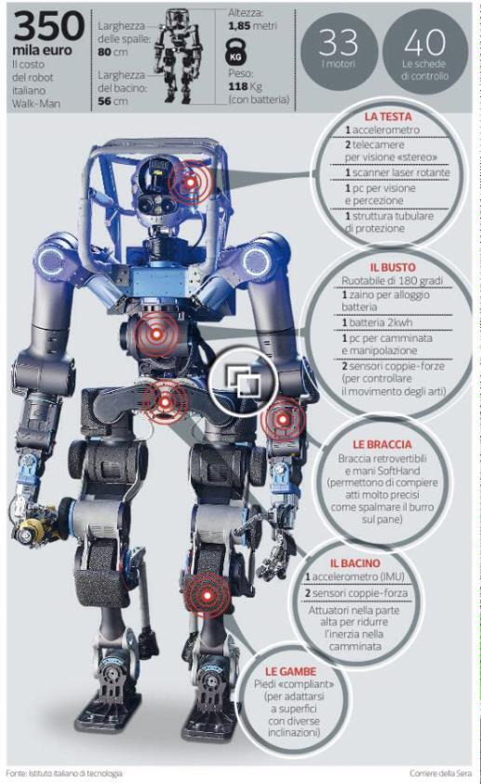




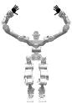
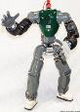



Manipulation
Modules
Pilot
Interface
Whole-Body Modules
RobotInterface
Locomotion
Module
Footstep &
Trajectory Planners
Walkman
Coman
Perception

Slide 59
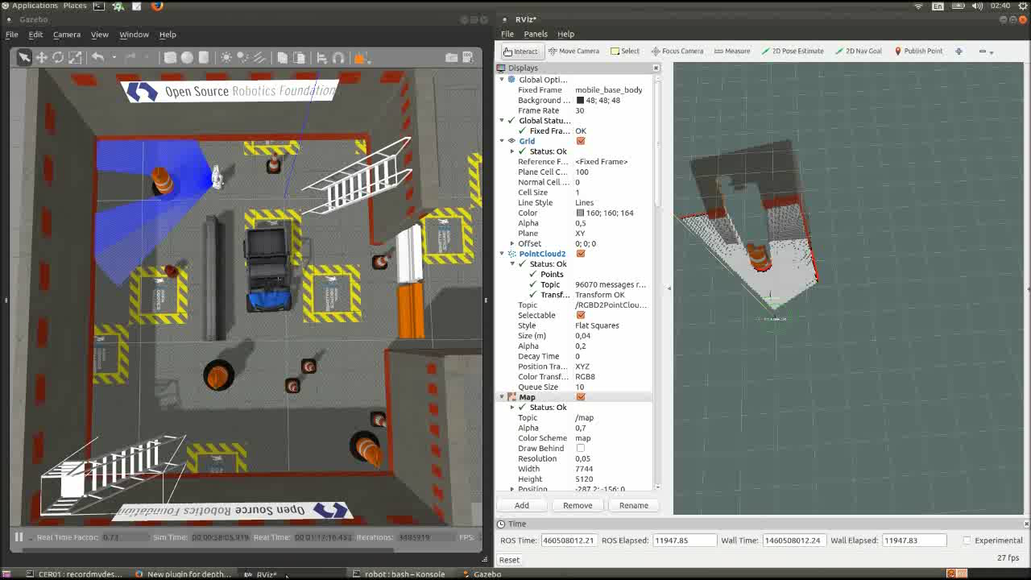
ROS gmapping, RVIZ, Gazebo

Slide 60
Port monitor
Paikan, A. et al, Data Flow Port's Monitoring and Arbitration, JOSER 2014

Slide 61
if (C1.certainty > 0.9)
accept(C1)
else
accept(C2)
arbitration
coordination
if (check(C1)
dispatch(event)
filtering
C1=filter(C1)
logging
dispatch(C1)
If (C1)
T1=getTime()
monitoring delays, QoS
Paikan, A. et al, Data Flow Port's Monitoring and Arbitration, JOSER 2014

Slide 62
Why Channel Prioritization (QoS)
HOST1
Robot

Slide 63
HOST1
20% load
Robot
switch

Slide 64
Channel prioritization
Bottlenecks
Robot
HOST1
HOST2
switch
Determinism is affected by:
Thead scheduling (CPU usage)
Packet conflicts (network usage)

Slide 65
Approach: improve determinism by increasing thread priorities and reducing network bottlenecks using QoS
> prop sched policy 1 priority 30
> prop set qos priority HIGH
Paikan et al., A Best-Effort Approach for Run-Time Channel Prioritization in Real-Time Robotic Application IROS 2015

Slide 66
20%/70% load
HOST1
Robot
switch
Standard YARP (20%)
With priority (20%)
Standard YARP (70%)
With priority (70%)

Slide 67
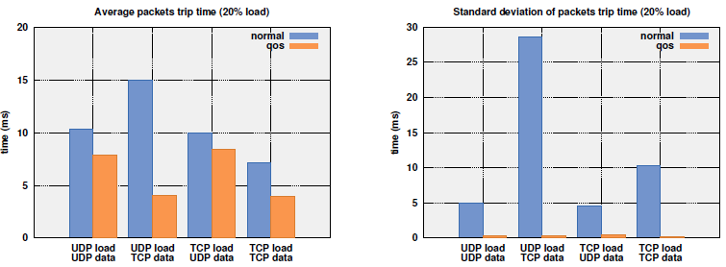
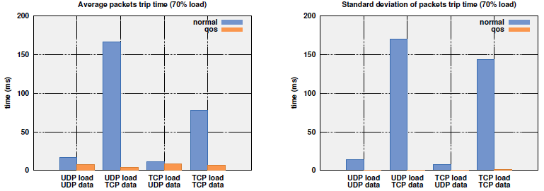
HOST1
Robot
20%/70% load
HOST2
switch

Slide 68
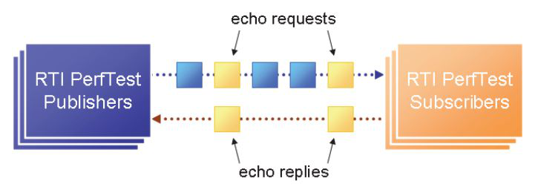
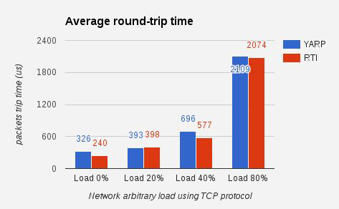
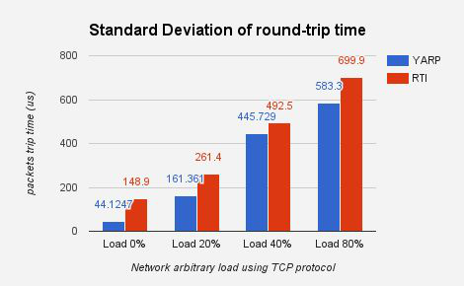
Comparison with DDS

Slide 69
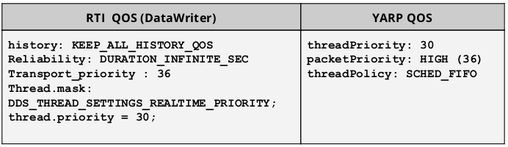
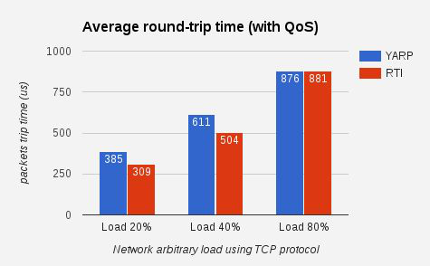
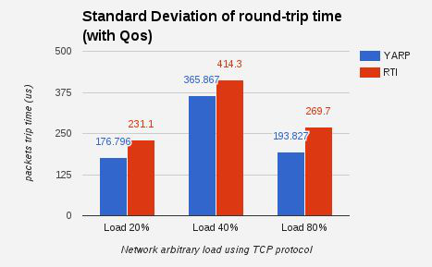
Comparison with DDS

Slide 70
An application

Slide 71



Acknowledgements
Ali Paikan (YARP, port monitor, channel prioritization)
Daniele Domenichelli (YARP, ROS-YARP)
Alberto Cardellino (YARP, robot interface, ROS-YARP)
Marco Randazzo (robot interface, firmware)
Andrea Ruzzenenti (simulator, slam)
Marco Accame (firmware)
Valentina Gaggero (firmware)
Alessandro Scalzo (firmware)
Ugo Pattacini
Vadim Tikhanoff
Silvio Traversaro
Francesco Romano
Francesco Nori
Giorgio Metta
Notes:
8 people, mostly technicians, 1 postdoc
Collaborations with other groups

Slide 72
Thank you

